Slide 1

LACO /

Slide 2
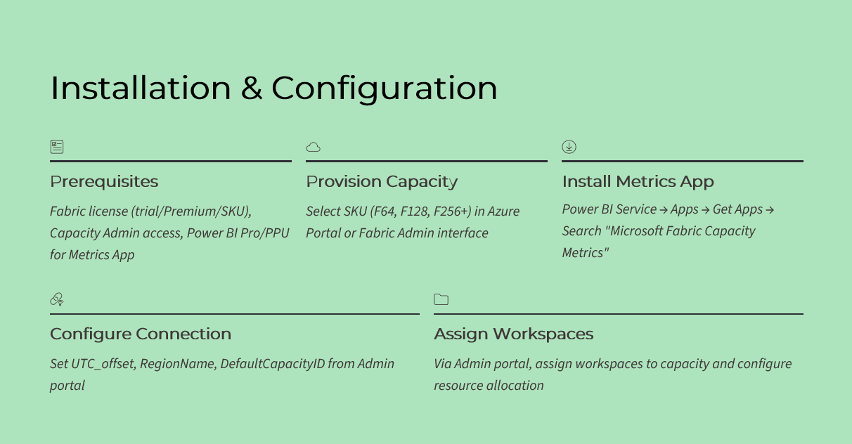
LACO /

Slide 3
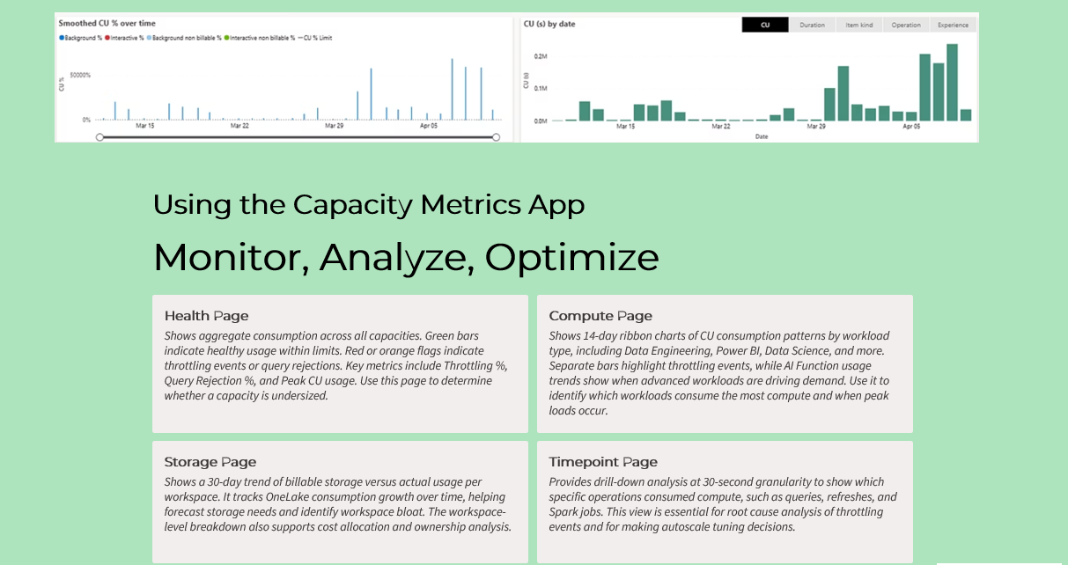
LACO /

Slide 4

LACO /
Health (Preview) - Fabric Capacity Metrics – Fabric

